Slide 1



CAPSTONE PROJECT

Slide 2
ACTIONABLE
Data Exploration and Summarization
Data Cleaning and Statistical Analysis
Graphical Analysis and Insights using Excel
Database Setup and SQL Operation
Running Queries in SQL
Data Import to Power BI from SQL Database
Interactive Dashboard Creation in Power Bi
Conclusion

Slide 3

Data Exploration And Summarization
01

Slide 4
Key Insights On the Data
In the data set there are 16 Columns which contains different variables like Segments, Country, Product, Discount Band, Units Sold, Manufacturing Price, Sales Price, Gross Sale, Discounts, Sales, COGS, Profit, Date, Month Number, Month Name and Year.
These Columns contains different types of columns. They are as follows;
05 categorical column
10 numeric column &
01 date wise column
In the data set there are 700 rows which contains different values like numerical, Textual and non-numerical values. Specially, Discount Column contains 53 non-numerical data.

Slide 5
VARIABLE OVERVIEW
01
02
03
Categorical Variables:
Numerical Variables:
Date wise Variables:
Segment: 5 unique values
Country: 5 unique values
Product: 6 unique values
Discount Band: 4 unique values
Units Sold: 510
Manufacturing Price: 6
Sale Price: 7
Gross Sales: 550
Discounts: 515
Sales: 559
COGS: 545
Profit: 557
Date: 16 unique values
Month Number: 12 unique values
Month Name: 12 unique values
Year: 1 unique value

Slide 6

02
Data Cleaning and Statistical Analysis

Slide 7
Data cleaning Steps
Structured the columns according to their nature of the values: It stored before in appropriate format. Such as columns which represents currency was stored in custom format, due to that calculation could be difficult during analysis so I change it as currency format.
Removed extra spaces within the values and texts.
Modified column into standardised way: As most of the columns are not stored as their natural position like adjusted text value in left side of the column and numbers in right side of the column.
Replaced the non-numerical value $ - with $0 through customising method which was earlier stored in Discount column.

Slide 8
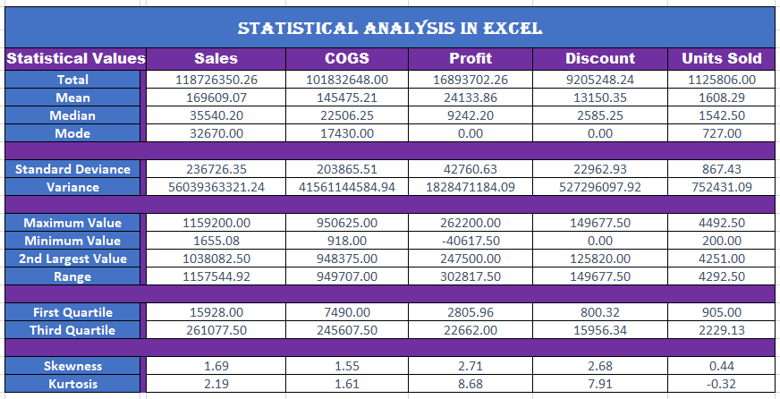
Statistical Analysis

Slide 9
Key InsightsOn Statistical Analysis Table
The data in the table reveals that for the sale of 1,125,806 units of overall products, manufacturing companies offered an average discount of 7.75% and generated a profit of 16.58% on total sales of $118,726,350.26.
A statistical analysis of the data shows variations in the mean, mode, and median values, indicating that the data is not normally distributed for the period 2013-14.
Furthermore, the data suggests that profits fall within a range of $302,817.50, indicating that overall, companies are generating profits from selling their products in the market.

Slide 10

03
Graphical Analysis using Excel

Slide 11
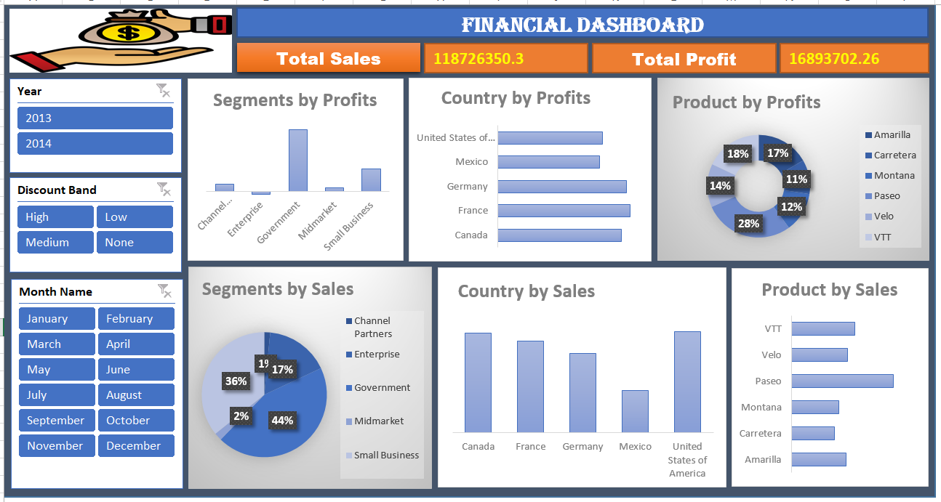
Graphical Analysis

Slide 12

Data Base Setup And SQL Operation
04

Slide 13
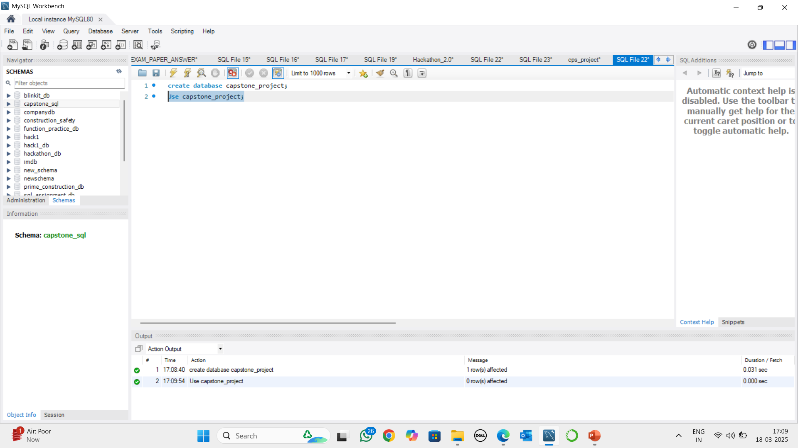
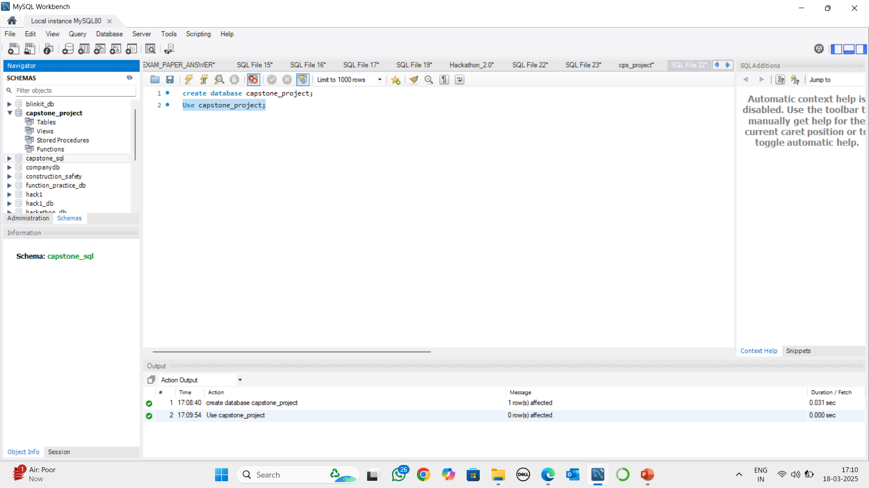
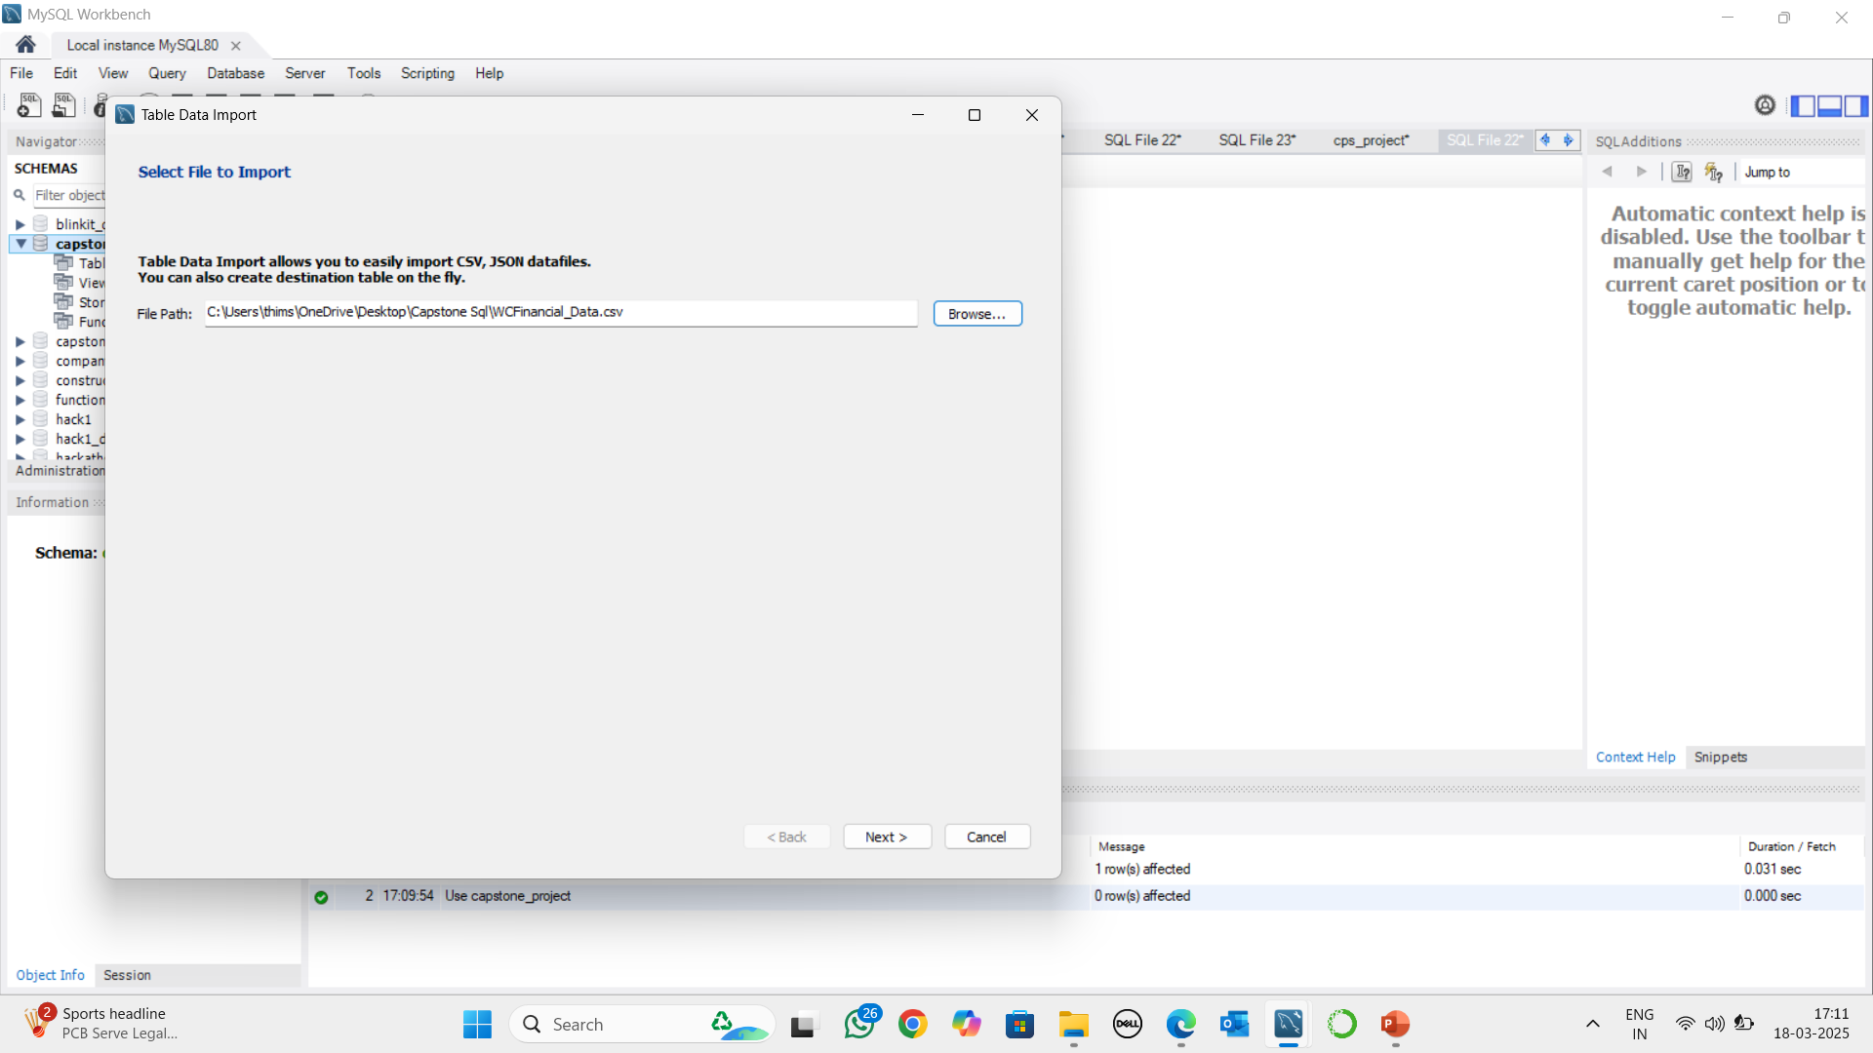
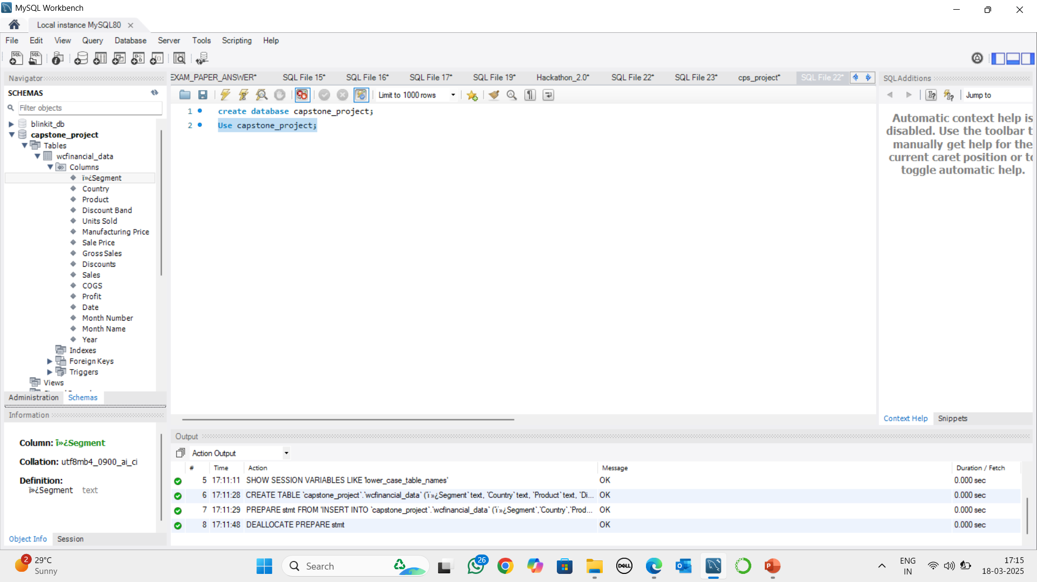
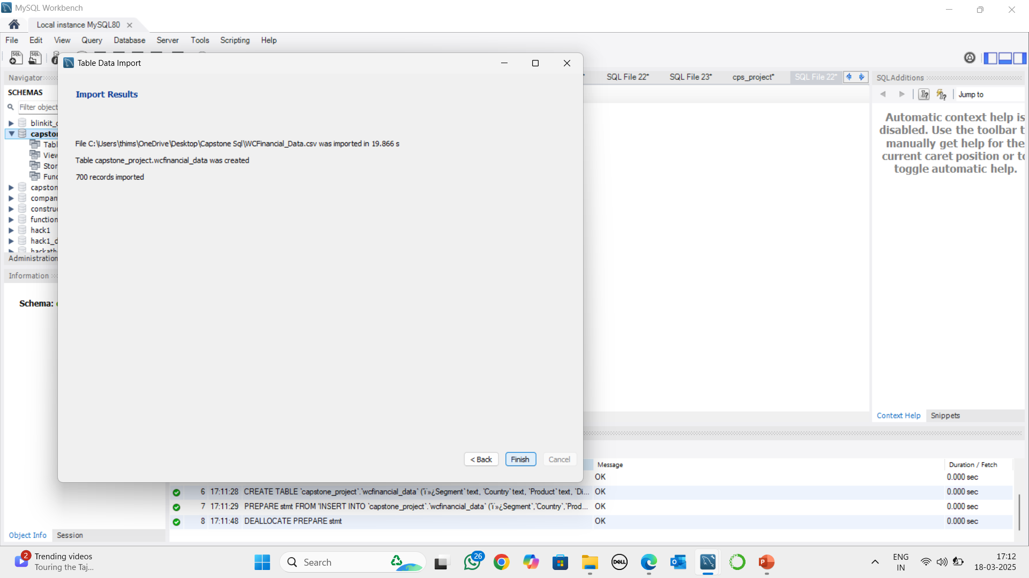
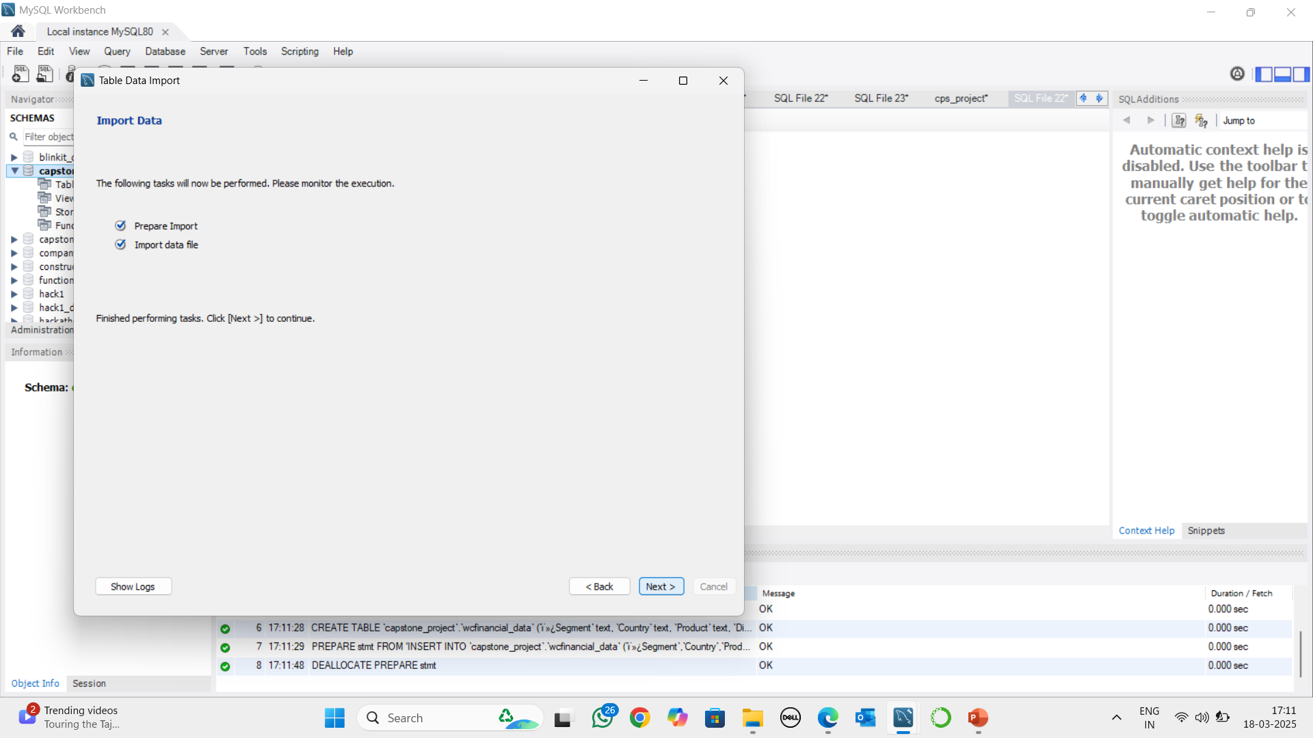
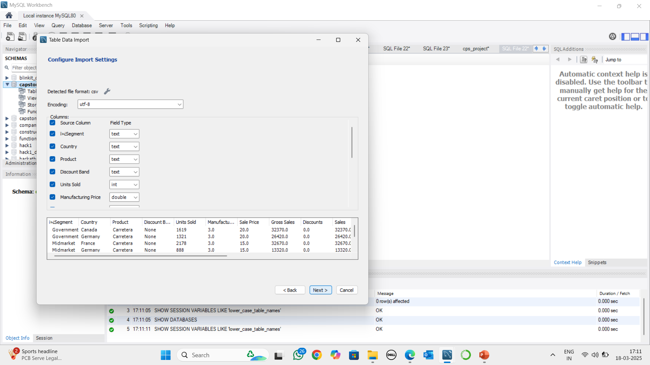
Data Base Setup And SQL Operation
Data Base Creation
Data Base Created
Importing Data Set
Data Set Loaded
Data Set Loading Process
Data Type Addition
Showing in Data Base

Slide 14
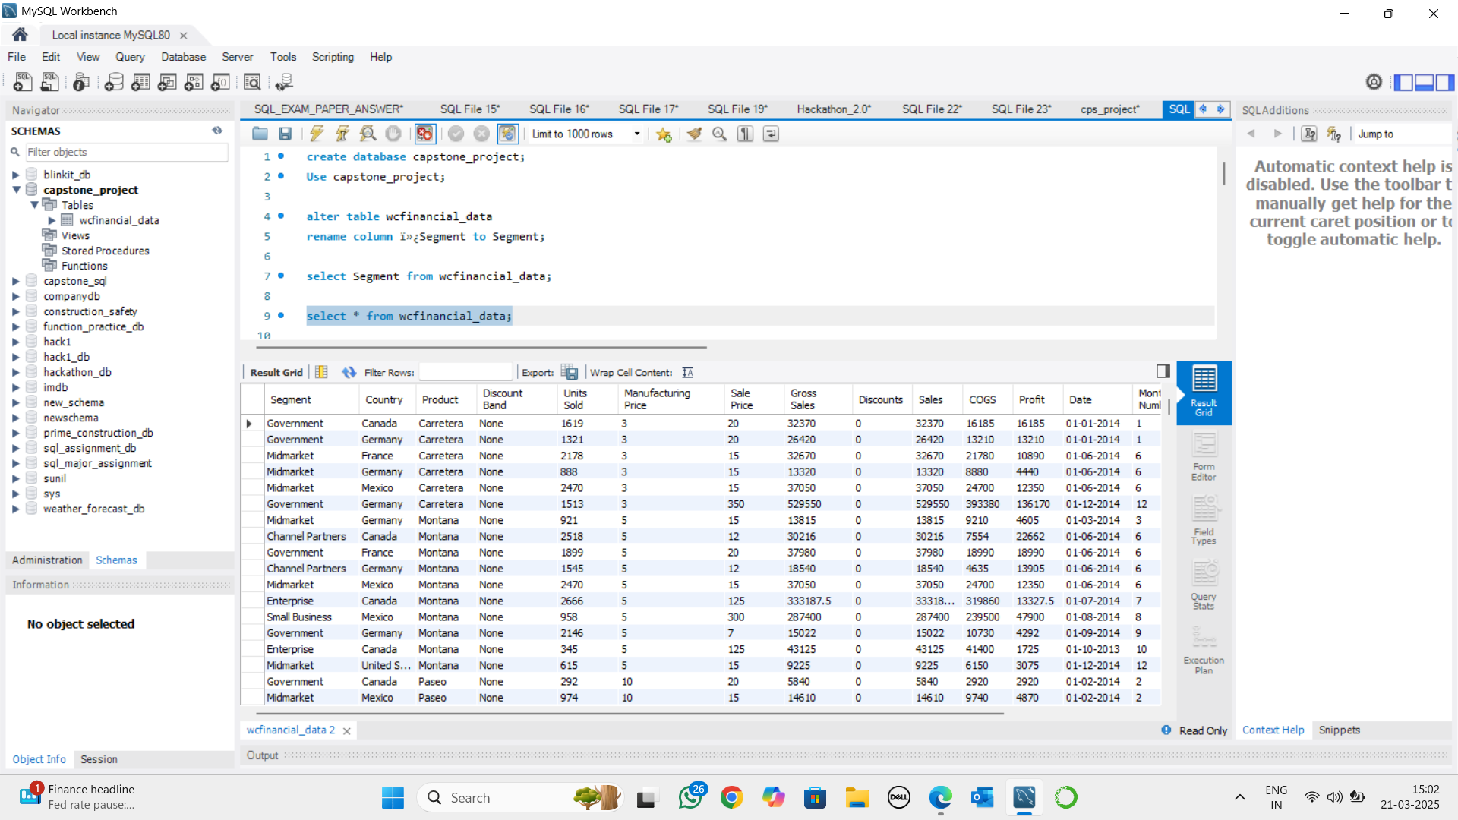
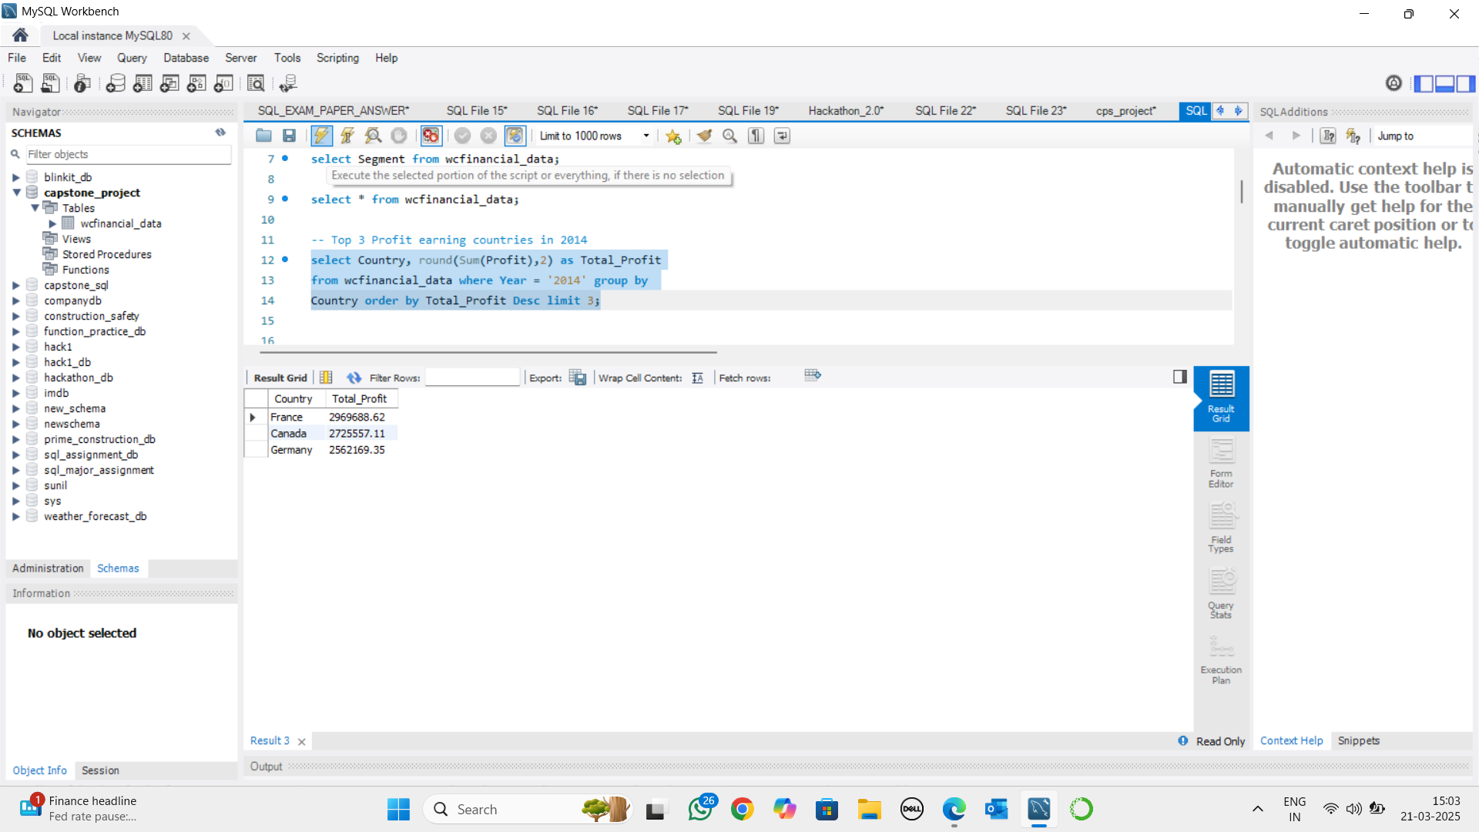
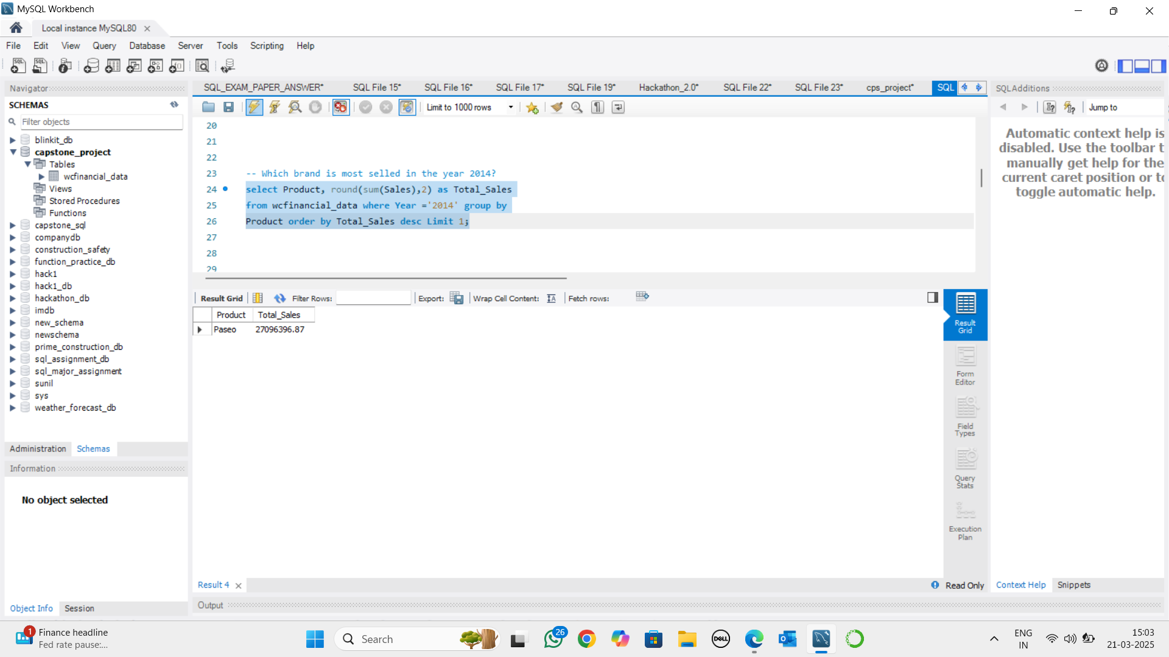
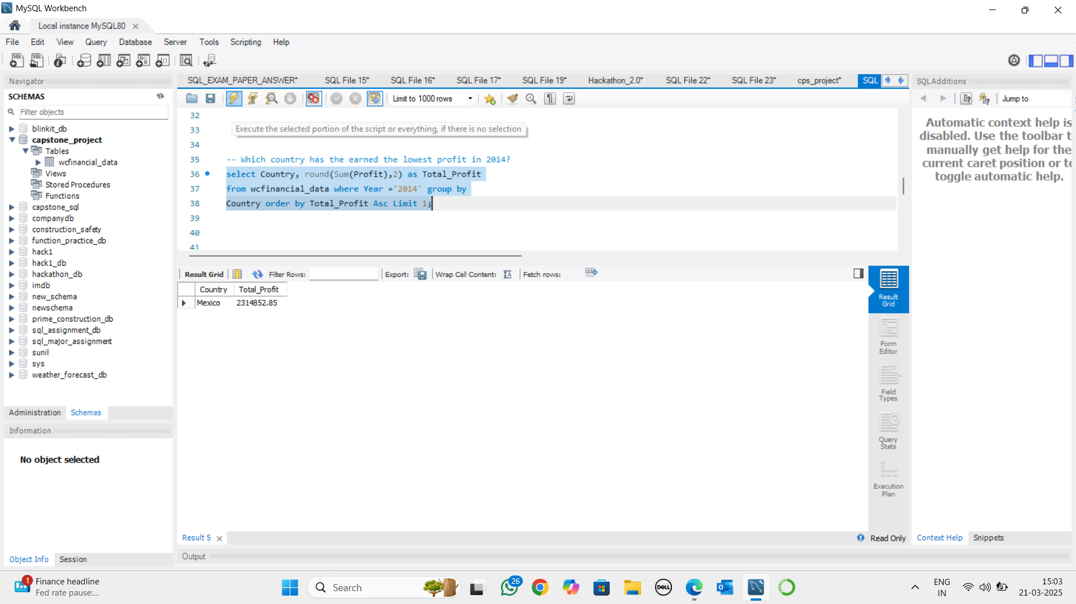
Running Queries In SQL
SQL Queries
SQL Out Comes

Slide 15

Data Import To Power Bi From SQL Data Base
05

Slide 16
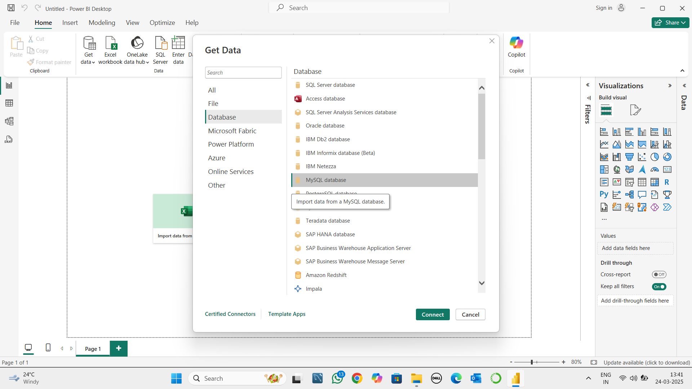
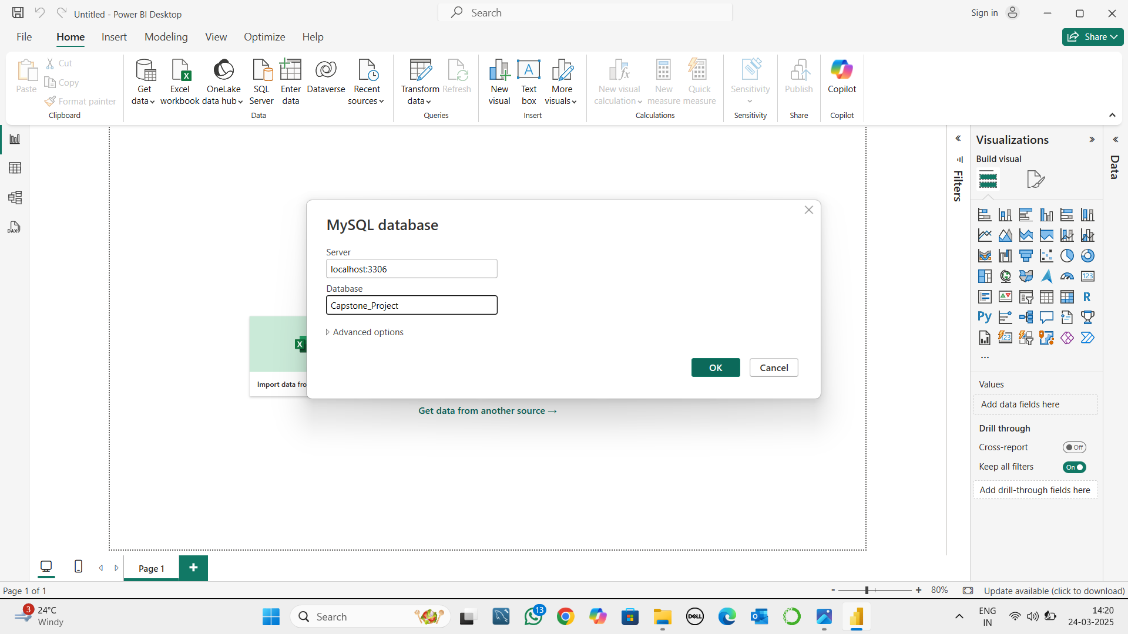
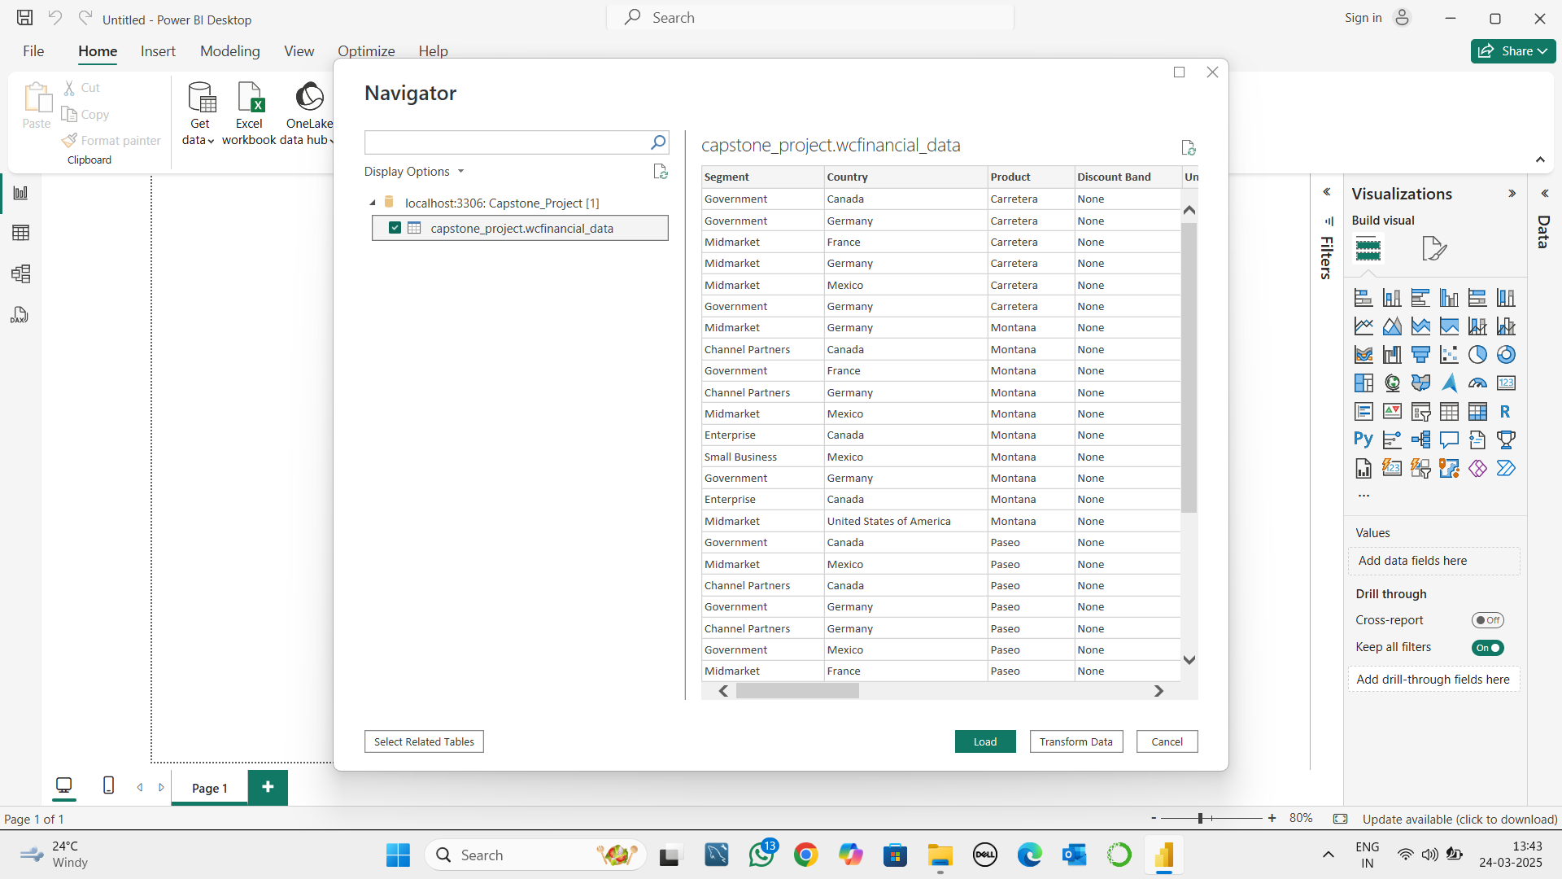
Data Import to Power Bi From SQL Data Base

Slide 17
Data Importing Steps
Opened Power Bi and navigate to home tab
Clicked on “Get Data” and selected “My SQL Data Base” from the list
Entered the server address as “localhost:3306”
Entered the data base name as “Capstone_Project”
Clicked OK button and chooses required table “wcfinancial_data” for transfer file to power query editor page
Made necessary changes for data visualisation purpose.
Loaded the data into Power Bi dashboard and Performed the necessary visualisation process.

Slide 18

Interactive Dashboard Creation in Power Bi
06

Slide 19
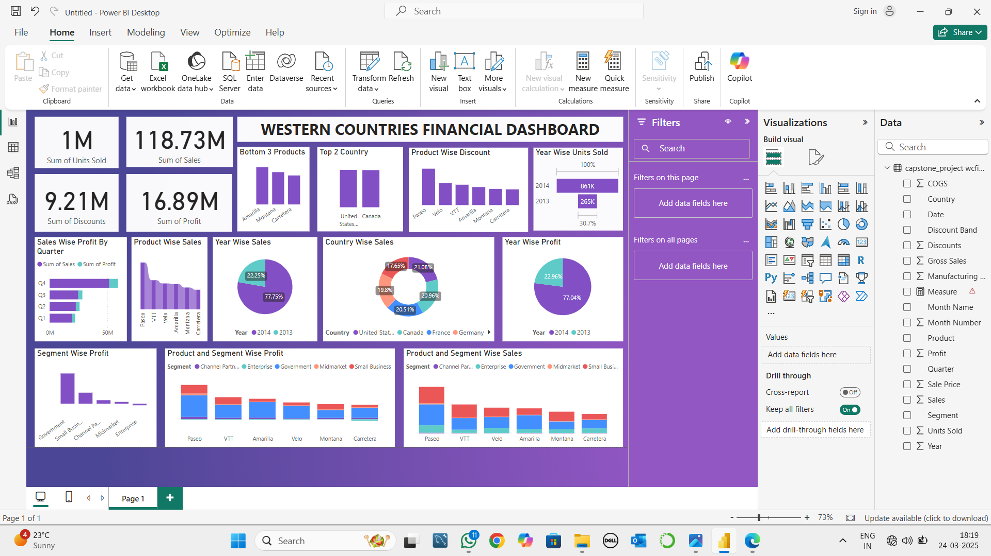
Power Bi Dash Board

Slide 20

Conclusion
07

Slide 21
Key Insights and Conclusion On The Western Countries Financial Data
As appears in the Western Country Sales Data 78% of the sales occurs in year 2014 which indicates YOY products are gained significant growth on their sales.
USA and Canada has emerged as top most product selling countries and Mexico has in the bottom line of the sales.
77% of the sales comes in the year 2014 and rest 23% in 2013.
In year 2014 861k units are sold and in 2013 there are 265k units. Which describes demand for the products are tripled on Year on Year basis.
In segment wise profit Government Segment has emerged has highest profit earning segment and Enterprise segment has in negative side of their earnings.
In Product and Segment wise Profit Paseo has earned more profit when compared to its rivalries where as Montona and Carretera Products are least in the list.
In Product and Segment wise sales Paseo gained the top position and Carretera in the bottom least side of the sales.
Paseo issued most no of discounts to sell to sell their products and Carretera issued less no. of discounts which signifies customers are shown keen interest to buy discounted product.
During Quarter-4 (October to December) there is a significant growth in sales when compare to Quarter-1 (January to March) which describes companies can invest more on Q4 to earn profit.

Slide 22
THANKS!
Created & Designed By:
Sunil Kumar
thimsun.herur@gmail.com
+971528210839, +971547790493

